Slide 1
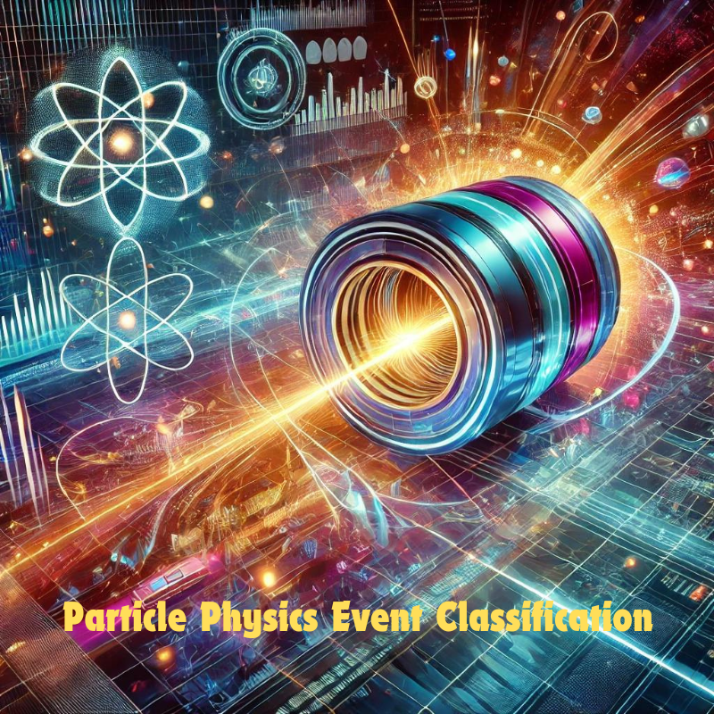

Slide 2
Particle Physics Event Classification
A Machine Learning Project
INDIVIDUAL PROJECT BY:
Vatsal Shah
vatsal793@gmail.com

Slide 3
Problem Description
In the field of particle physics, accurate identification and classification of events are crucial for understanding fundamental particles and their interactions.
The goal of this project is to build a machine learning model that can classify events as either signal (s) or background (b).
This classification will help distinguish between events of interest (signal) and background noise, contributing to the advancement of research in particle physics.

Slide 4
Dataset Overview
The dataset consists of 250,001 rows and 33 columns. Each row represents an event, and the columns contain features derived from particle physics experiments.
The dataset contains features related to particle physics events, including kinematic properties of the particles. The target variable indicates whether an event is signal or background.

Slide 5
Approach
1. Data Preprocessing: Handling missing values, normalization, and feature selection.
2. Exploratory Data Analysis (EDA): Analyzing the distribution of features and their relationship with the target.
3. Model Building: Training machine learning models to classify events.
4. Model Evaluation: Using metrics like accuracy, precision, recall, and ROCAUC to evaluate performance.
5. Conclusion & Recommendations: The model achieved perfect classification, highlighting the effectiveness of Random Forest, with future enhancements suggested for realtime applications and expanded feature exploration.

Slide 6
Data Preprocessing
1. Handling Missing Values:
Checked for placeholder values like 999 and missing entries in the dataset.
Dropped columns with more than 50% missing values.
Imputed missing values in numeric columns using the median.
2. Feature Encoding:
Encoded the target variable ('Label') into a binary format (`1` for signal, `0` for background).
Removed the original 'Label' column after encoding.
3. Correlation Analysis:
Separated the dataset into features (X) and target (y).
Applied an 8020% split to create training and testing sets.
4. Handling Class Imbalance:
Applied SMOTE (Synthetic Minority Oversampling Technique) to address class imbalance in the dataset.

Slide 7
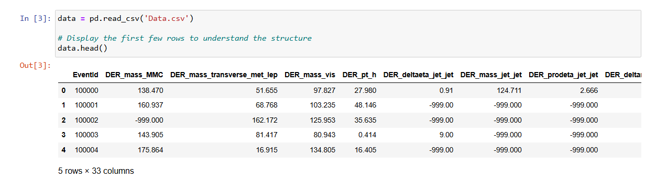
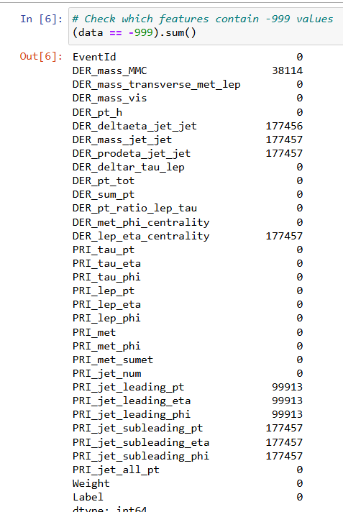
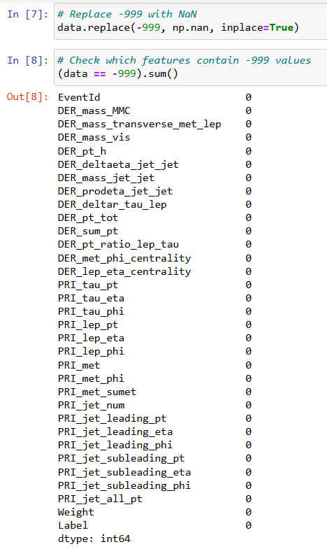

Slide 8
Exploratory Data Analysis
1. Feature Distribution:
Analyzed the distribution of key numerical features (e.g., `DER_mass_MMC`, `PRI_tau_pt`) to understand their spread and detect potential anomalies.
2. Correlation Analysis:
Computed and visualized the correlation matrix to identify significant relationships between features.
Helped in understanding feature interdependencies and selecting important features for model building.
3. Target Variable Analysis:
Visualized the distribution of the target variable to assess class imbalance.
Found that the dataset was imbalanced, with more background events than signal events.
4. Class Imbalance:
Identified the need to address class imbalance, leading to the application of SMOTE during data preprocessing.

Slide 9
Exploratory Data Analysis Feature Distributions
Feature Insights:
DER_mass_MMC: Shows a right-skewed distribution with most values clustering towards the lower end. This suggests that most events have a relatively lower combined mass.
DER_mass_transverse_met_lep: Also right-skewed, indicating that the majority of events have a low transverse mass when considering missing transverse energy and lepton information.
DER_mass_vis: Similar to `DER_mass_MMC`, this feature has a high concentration of lower values, indicating that most events have a smaller visible mass.
PRI_tau_pt: The distribution is highly skewed towards lower values, suggesting that the transverse momentum of the tau particle is generally low in the dataset.
PRI_met: Displays a heavy right tail, indicating that while most events have low missing transverse energy, there are a few events with significantly higher values.
Conclusion: These distributions highlight that several key features exhibit skewness, implying the need for appropriate preprocessing steps such as normalization or transformation to ensure effective model training.

Slide 10
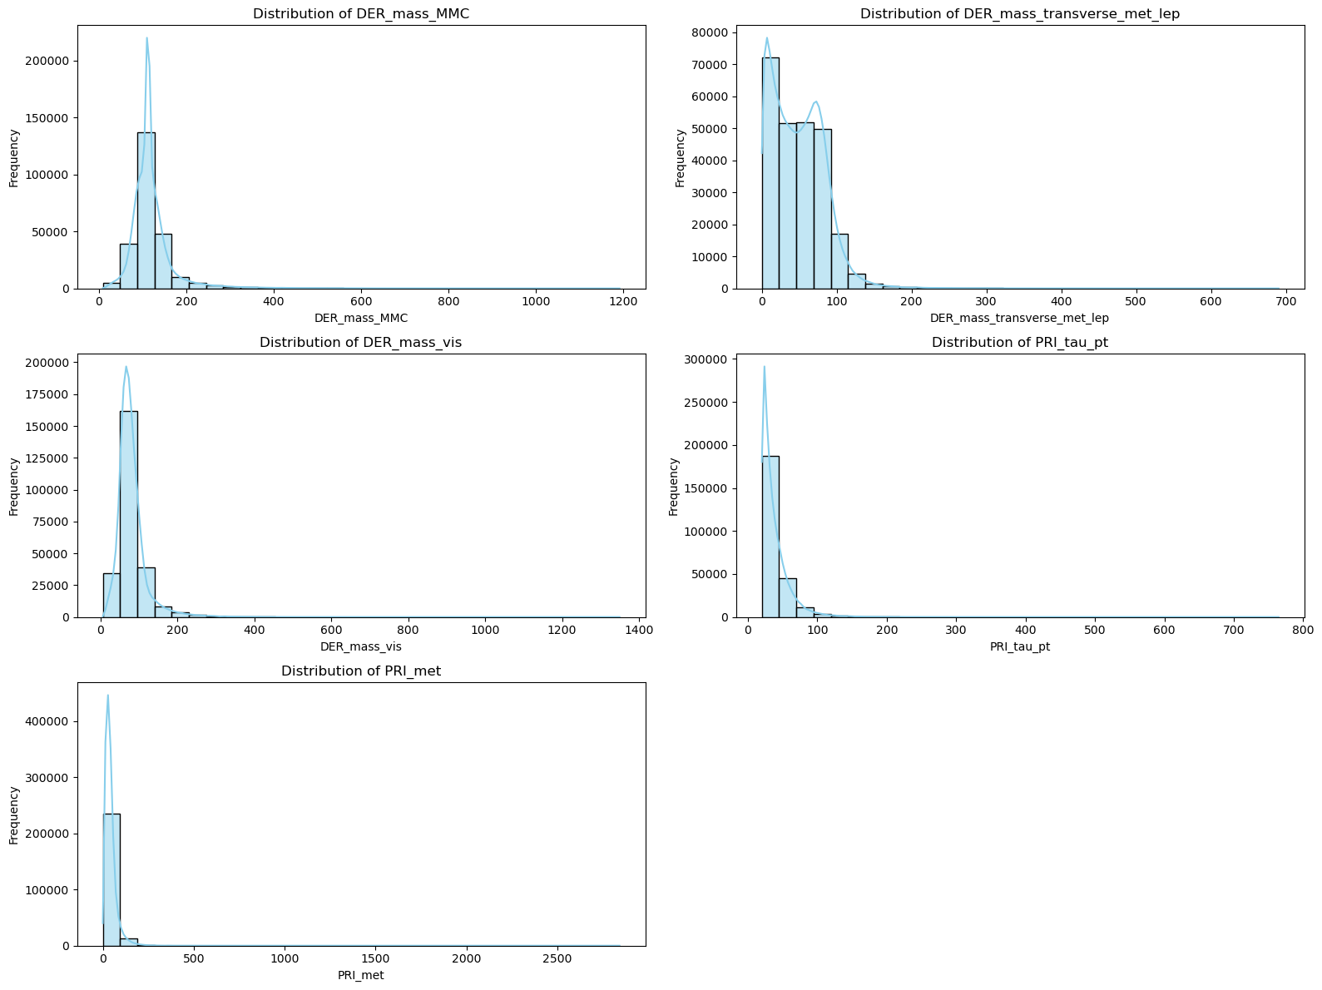

Slide 11
Correlation Heatmap
Overview: This heatmap visualizes the correlation between different features in the dataset, showing how they relate to one another. The color intensity indicates the strength and direction of the correlation, with red representing positive correlations and blue representing negative correlations.
Key Insights:
Strong Positive Correlations:
DER_mass_MMC and DER_mass_vis show a strong positive correlation, indicating that events with a higher visible mass also tend to have a higher combined mass.
PRI_met and PRI_met_sumet also exhibit a strong positive correlation, suggesting that these features capture related aspects of the event's energy.
Strong Negative Correlations:
PRI_jet_num and PRI_met_phi display a notable negative correlation, indicating an inverse relationship between the number of jets and the missing transverse energy's direction.
Weak Correlations with Label_encoded:
Most features exhibit weak correlation with the target variable (Label_encoded), implying that the classification task may rely on complex patterns rather than linear relationships.

Slide 12
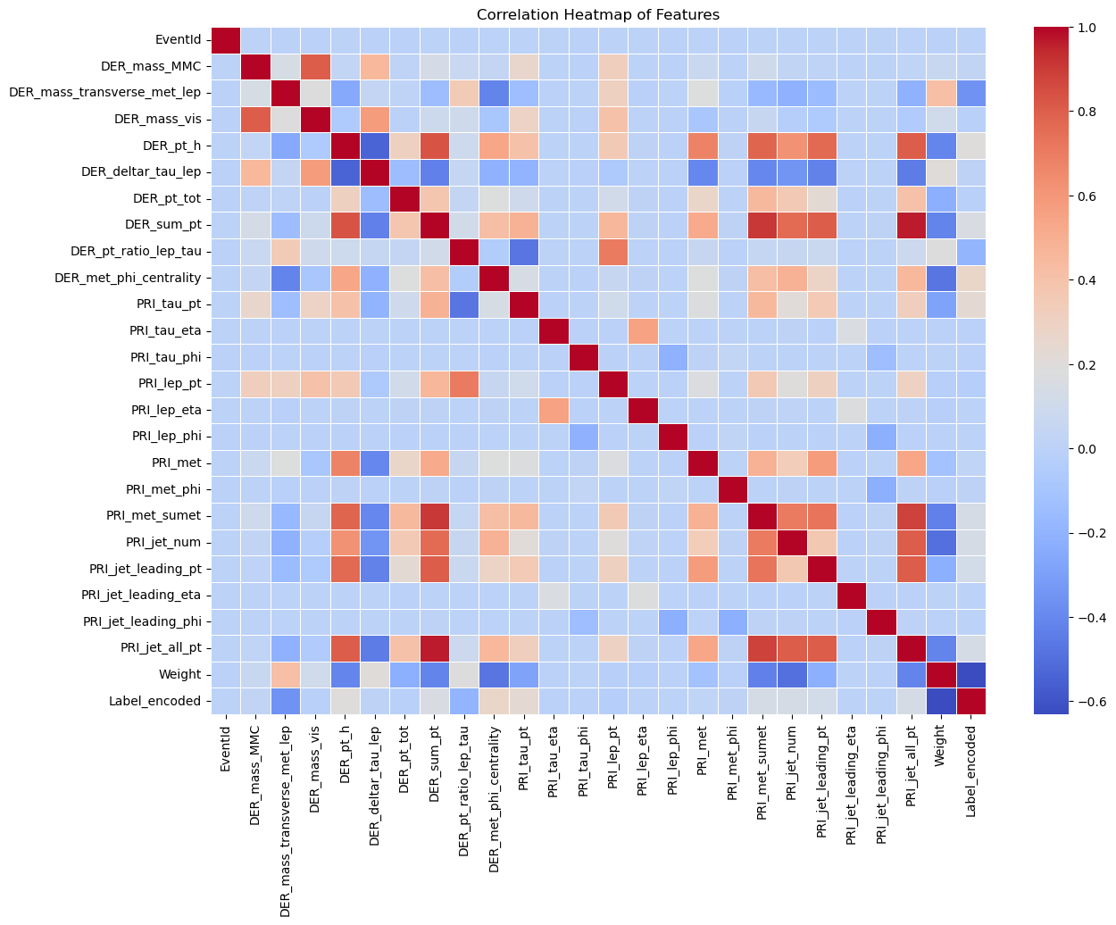

Slide 13
Class Distribution Before and After SMOTE
The graphs depict the distribution of the target variable (Class 0 = Background, Class 1 = Signal) before and after applying the Synthetic Minority Over-sampling Technique (SMOTE) to address class imbalance.
Before SMOTE:
The dataset was imbalanced, with a significantly higher number of background events (Class 0) compared to signal events (Class 1).
This imbalance could lead to biased model performance, favoring the majority class during classification.
After SMOTE:
SMOTE was applied to oversample the minority class (signal events) to create a balanced dataset.
Both classes now have an equal count, ensuring that the model receives a balanced representation of both event types during training.
Conclusion: Addressing class imbalance using SMOTE helps improve model performance by preventing it from being biased toward the majority class, thereby enhancing the model's ability to accurately classify both background and signal events.

Slide 14
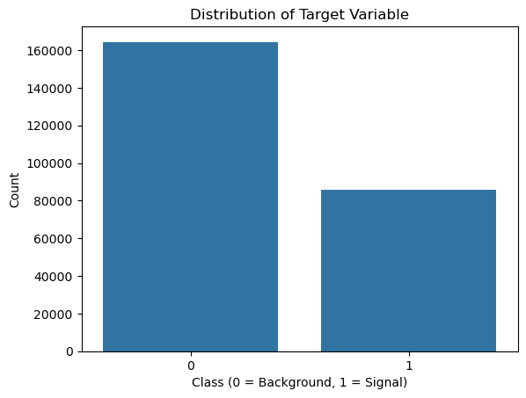
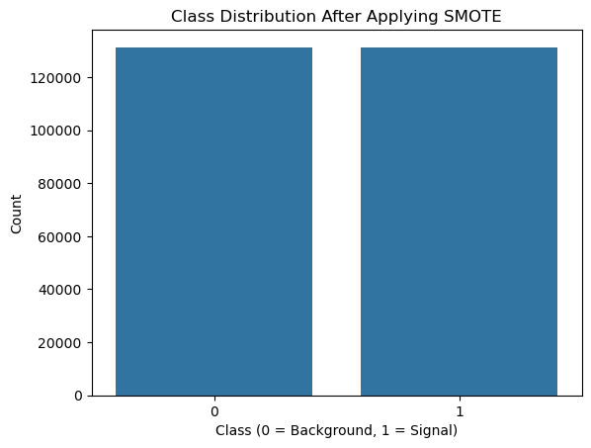
Before SMOTE
After SMOTE

Slide 15
Feature Engineering
Weight: Dominates feature importance, indicating its critical role in classifying particle physics events.
DER_mass_MMC: Represents the combined mass of detected particles, a key feature in identifying event characteristics.
DER_mass_transverse_met_lep: Provides insight into the event's energy distribution, aiding in distinguishing between signal and background.
DER_mass_vis: Captures the visible mass of the event, helping to differentiate signal events.PRI_tau_pt: Indicates the transverse momentum of the tau particle, crucial for understanding particle interactions.
DER_met_phi_centrality: Measures the centrality of the missing transverse energy, contributing to the event's spatial configuration analysis.

Slide 16
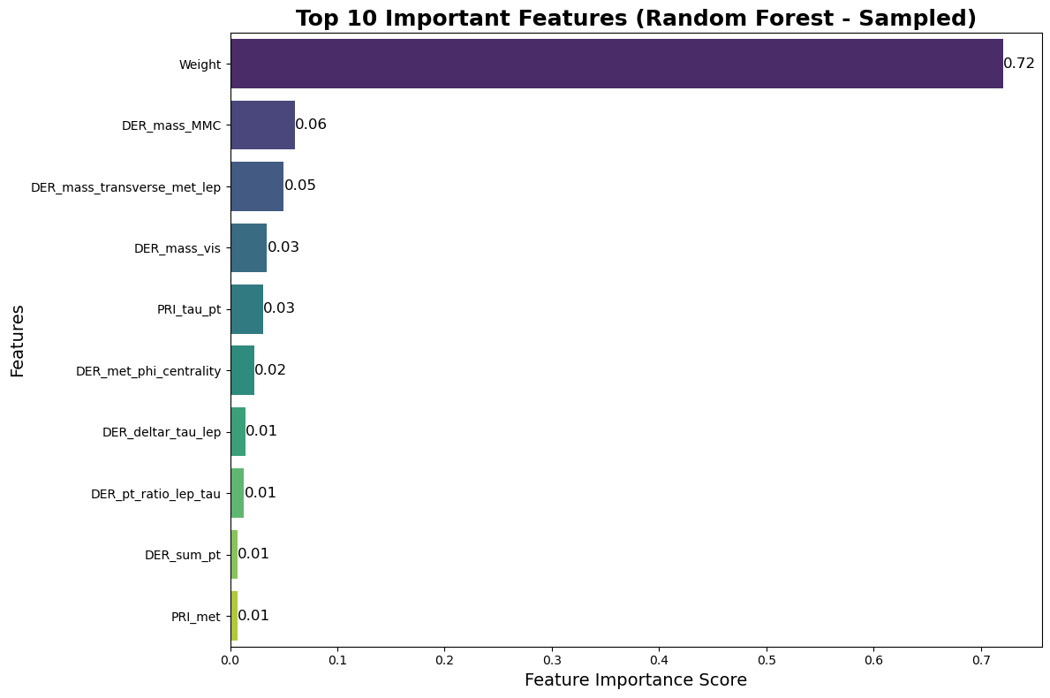

Slide 17
Model Training and Evaluation
Model: Random Forest Classifier
Performance:
CrossValidation Accuracy: Achieved a mean accuracy of 1.0 across folds.
Confusion Matrix:
True Positives (Signal): 26,273
True Negatives (Background): 26,235
Classification Report:
Precision: 1.00 for both classes
Recall: 1.00 for both classes
F1Score: 1.00 for both classes
Overall Metrics:
Accuracy Score: 1.0
ROC AUC Score: 1.0

Slide 18
Conclusion and Recommendations
Key Findings
Model Performance:
The Random Forest model achieved perfect classification on both the sampled and original datasets, with an accuracy, precision, recall, and ROCAUC score of 1.000.
This indicates the model's strong capability to distinguish between signal and background events with high reliability.
2. Feature Importance:
The analysis revealed that features like `Weight`, `DER_mass_MMC`, and `DER_mass_transverse_met_lep` play a critical role in predicting the event type.
These features, particularly `Weight`, were found to have a substantial impact on the model's ability to classify events accurately, providing valuable insights into the underlying physics of particle interactions.

Slide 19
Recommendations:
For Researchers:
Targeted Experiments: Researchers can focus on the most influential features identified by the model, such as `Weight` and `DER_mass_MMC`, to design more targeted experiments. Understanding why these features are crucial can provide deeper insights into particle physics phenomena.
Data Quality Improvement: To maintain and potentially improve the model's performance, researchers should continue to enhance the quality of the data, especially for the identified key features. Accurate measurement and calibration of these features can further refine classification accuracy.
2. For Model Deployment:
RealTime Classification: The high accuracy of the model suggests its applicability in realtime event classification in particle physics experiments. By integrating this model into particle detection systems, researchers can promptly identify significant events, facilitating faster and more efficient experimental analysis.
Continuous Monitoring and Adaptation: Although the model performed exceptionally on the given dataset, it's essential to monitor its performance over time, especially when deployed in varying experimental conditions. Regularly updating the model with new data can ensure it remains effective in diverse experimental setups.
3. Further Research and Enhancement:
Exploring Other Models: While Random Forest provided excellent results, exploring other models such as Gradient Boosting or Neural Networks might uncover additional nuances in the data. These models could be tested to see if they offer any incremental improvements or further insights.
Feature Engineering: Future efforts could include more advanced feature engineering, such as the creation of interaction terms or higherorder features, to explore whether the model's performance can be further enhanced or if it reveals more about the physics phenomena.
By leveraging the insights from this predictive model, researchers in particle physics can enhance the identification and analysis of significant events, contributing to a deeper understanding of fundamental particles and their interactions.

Slide 20


